Slide 1
EOMP #2
Mentor: Vu The Nam
Team: Base Steps Solution
Project: Van Lang Admission

Slide 2
Objective
Give what we have achieved in recent time
Current progress report
Given the problems that occurred in team and the lessons learned

Slide 3
Outline
Introduction project
Requirement
Architecture
Progress of project
Risk and issue report
Reflection

Slide 4
Introduction project

Slide 5
Base Steps Solution
Mentor: Vu The Nam
Members:
Nguyen Thai Hien
Tran Xuan Hai
Nguyen Hoang Anh Tai
Nguyen Anh Khoi
Doan Anh Minh
Nguyen Xuan Thai Hien

Slide 6
Project overview
Project name: Van Lang admission
Customer: Van Lang university
Goals:
Create a website Van Lang Admission for customer with high quality & the most reasonable price
Website can work with the best performance and take this site close to all student in Viet Nam
Website can help introduce all information and make a good look for Van Lang university
Website can help students lookup their admission information correctly & clearly

Slide 7
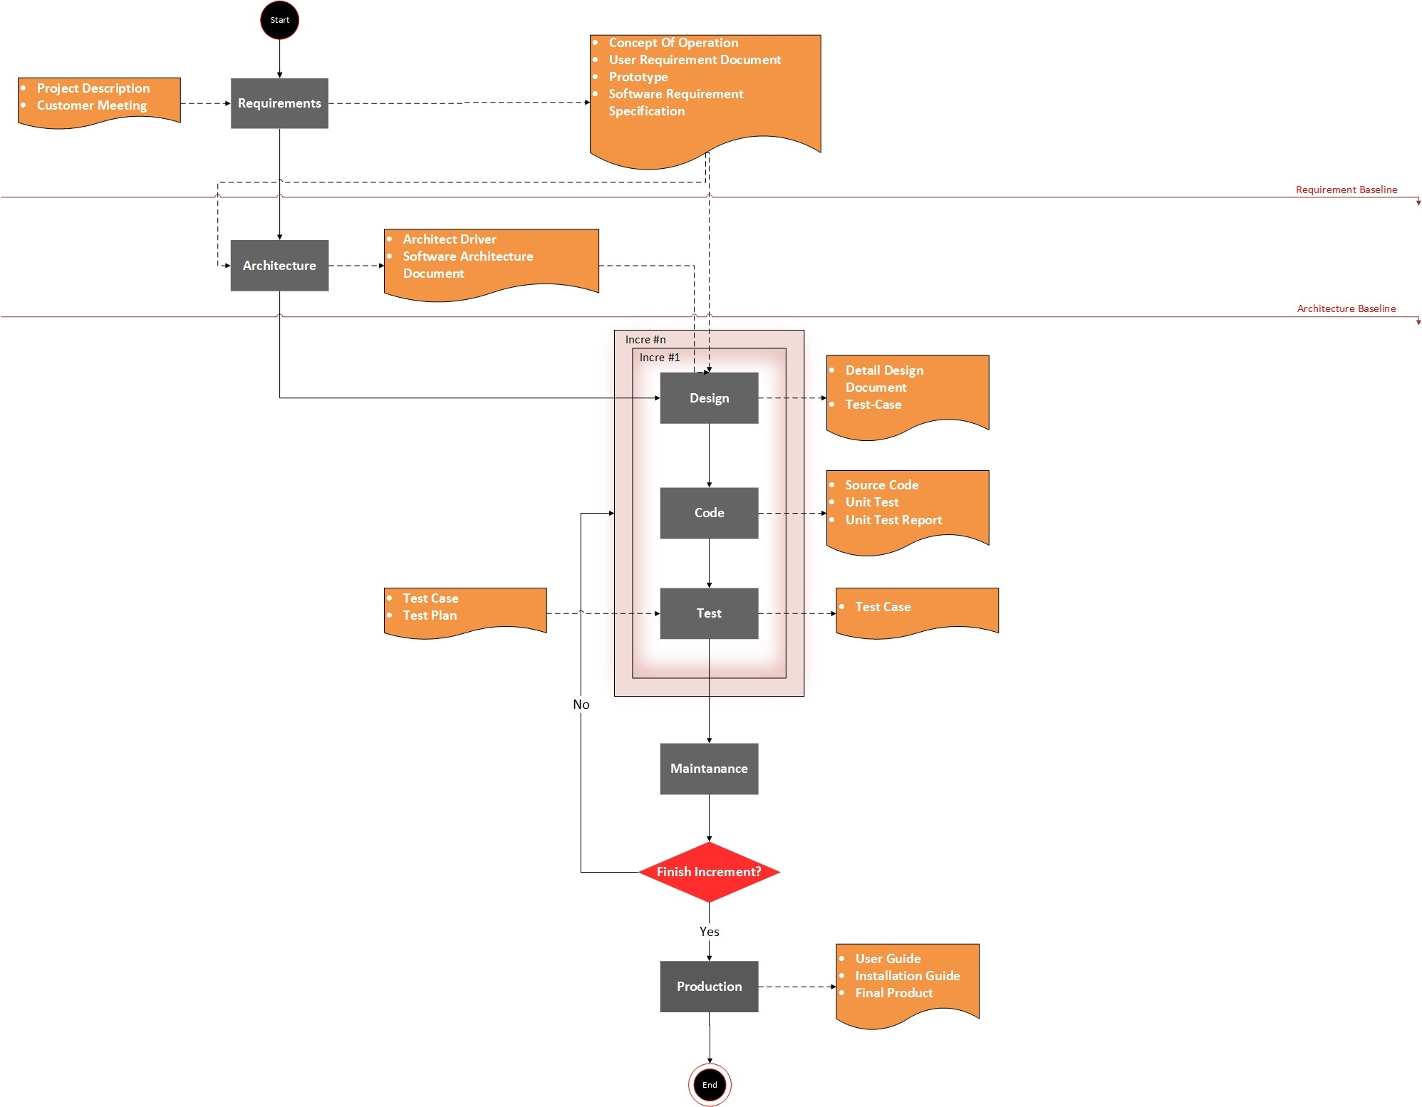
Software development process

Slide 8
Requirement

Slide 9
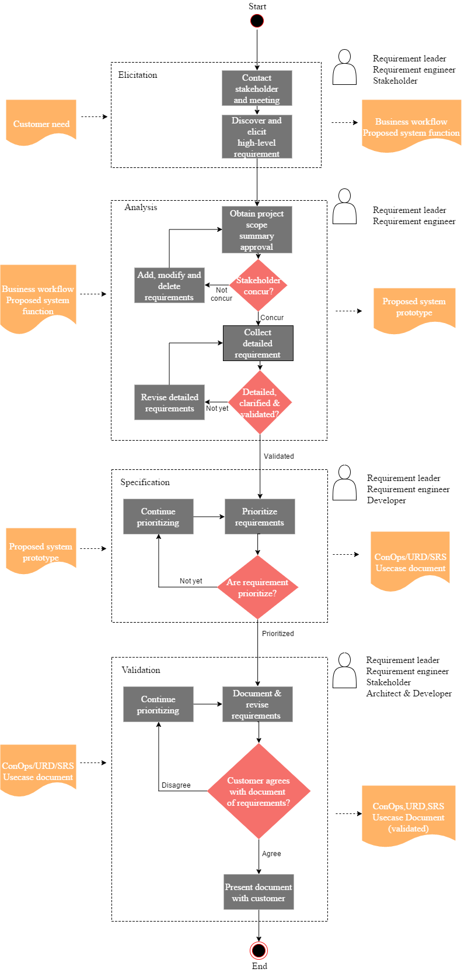
Requirement process

Slide 10
Quality attribute
Id | Quality Attribute | Description | Priority
SQA-P01 | Performance | When users use the system to view the necessary information, the system will respond quickly, display results in 2 seconds | High
SQA-P02 |  | Education staffs can import point into system average 1000 points will import about 4 seconds | High
SQA-A01 | Availability | When Web server unresponsive, can re-operation quickly | High
SQA-C01 | Scalability | System can expand limit number of users | High
SQA-U01 | Usability | System has friendly interface and easy to use | Medium
SQA-R01 | Portability | Users can use the system on mobile platform | Medium
SQA-M01 | Modifiability | The system can add/delete/modify other functions later | Medium
SQA-S01 | Security | System can authorize user’s information | Low

Slide 11
Architecture

Slide 12
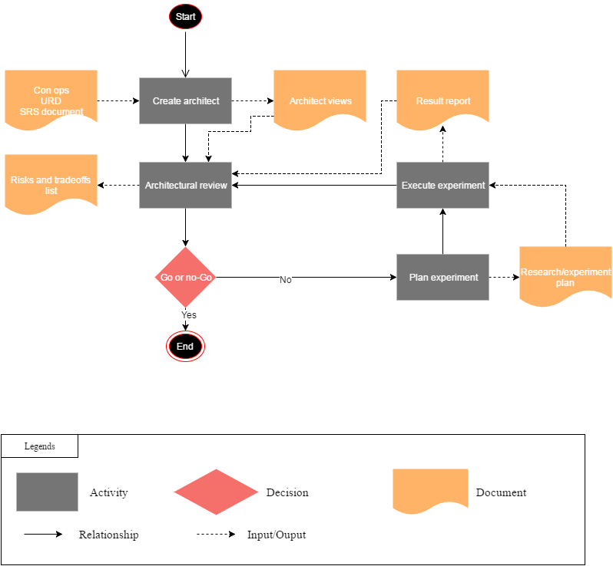
Architect process

Slide 13
Physical view

Slide 14
Dynamic view

Slide 15
Static view

Slide 16
Progress of project

Slide 19
Risk and issue report

Slide 20
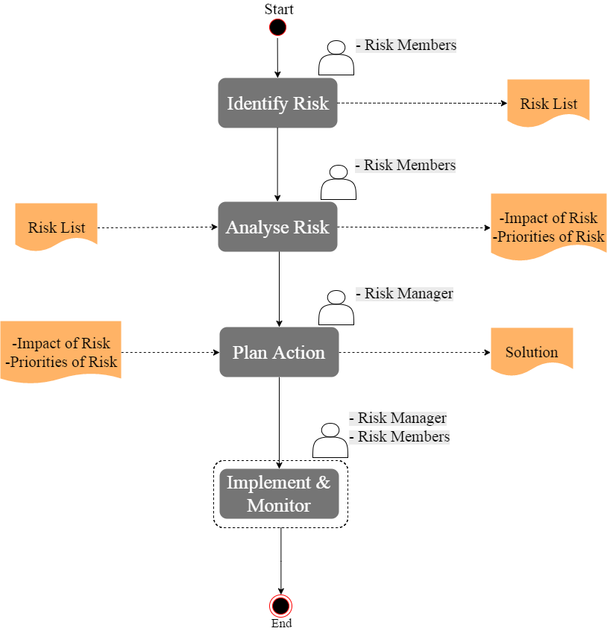
Risk management process

Slide 22
Reflection

Slide 23
ID | Issue | Solution | Actual Status | Result | Lession Learned
1 | Estimates are inaccurate | Team meeting and re-estimate. | Active | N/A | - Need to learn the method of estimating - Estimating together
2 | Lack of needed knowledge | Research and increase effort to study new programming language. | Active | N/A | - Need to prepare the study materials at beginning - Need regular practice
3 | Resources are inexperienced | All member research and read documents of previous course. | Fixed | Team members found a number of documents on the network & previous course | - Need to prepare the study materials from the beginning
4 | Errors in key project management processes | Team meeting to review each key process and modify them. | Fixed | Modify all document templates Synchronize all processes | - Modify all document templates at beginning - Draw process with one configuration
5 | Team members with negative attitudes towards the project | Team meeting to solve the problem. | Fixed | Have some team building to improve motivation of team work Team focused and eager to work together | - Member of team should respect each other - Prioritize work on top
6 | Inaccurate function priorities | Review with customer to define clearly for function priorities. | Fixed | Reviewed priorities of all function | - Need understand clearly about requirement of customer
7 | Architecture is infeasible | Research and collect advices from professor | Active | N/A | - Need to learn the method of estimating - Build base on Quality Attributes
8 | Delays to training impact the project | Increase effort for all members. | Active | N/A | - Need to trainning at beginning
9 | Customer rejects the prototype | Request some prototypes of others website to customer, re-design follow the choice of customer. | Active | N/A | - Need understand clearly about requirement of customer

Slide 24
Thank for your attention!

